Slide 1


DANA AL NASSER ENGINEERING OFFICE
Solicitation for Architectural and Engineering Design Proposal
Website: www.engdn.net
Contact us: info@engdn.net

Slide 2
Introduction
Dana Bassam Adeeb Al Nasser Engineering Office established in 2006, based in Riyadh, KSA, is a well-established engineering Saudi Arabia based firm specializing in comprehensive documentation services across the fields of Architecture, Engineering, and Interior Design. Our expertise spans all project phases—from Concept and Schematic Design through Design Development, Construction Documentation, and As-Built Drawings. We also provide structural stability assessments and verification for existing structures, among a broad range of other specialized services.

Slide 3

Contents
Mission and core values
Scope and methodology
Organization Chart
Key personnel
Our Affiliated Companies
Company Services
Our clients
Recent Projects
Certification & Registration Documents

Slide 4
Mission and core values
At DANA, our mission is to deliver innovative, high-quality engineering solutions at competitive market prices, while maintaining the highest standards of professionalism, integrity, and customer service. We are committed to building long-term relationships through client satisfaction, timely delivery, and attention to detail—driven by a dedicated team of experienced engineers and professionals.

Slide 5
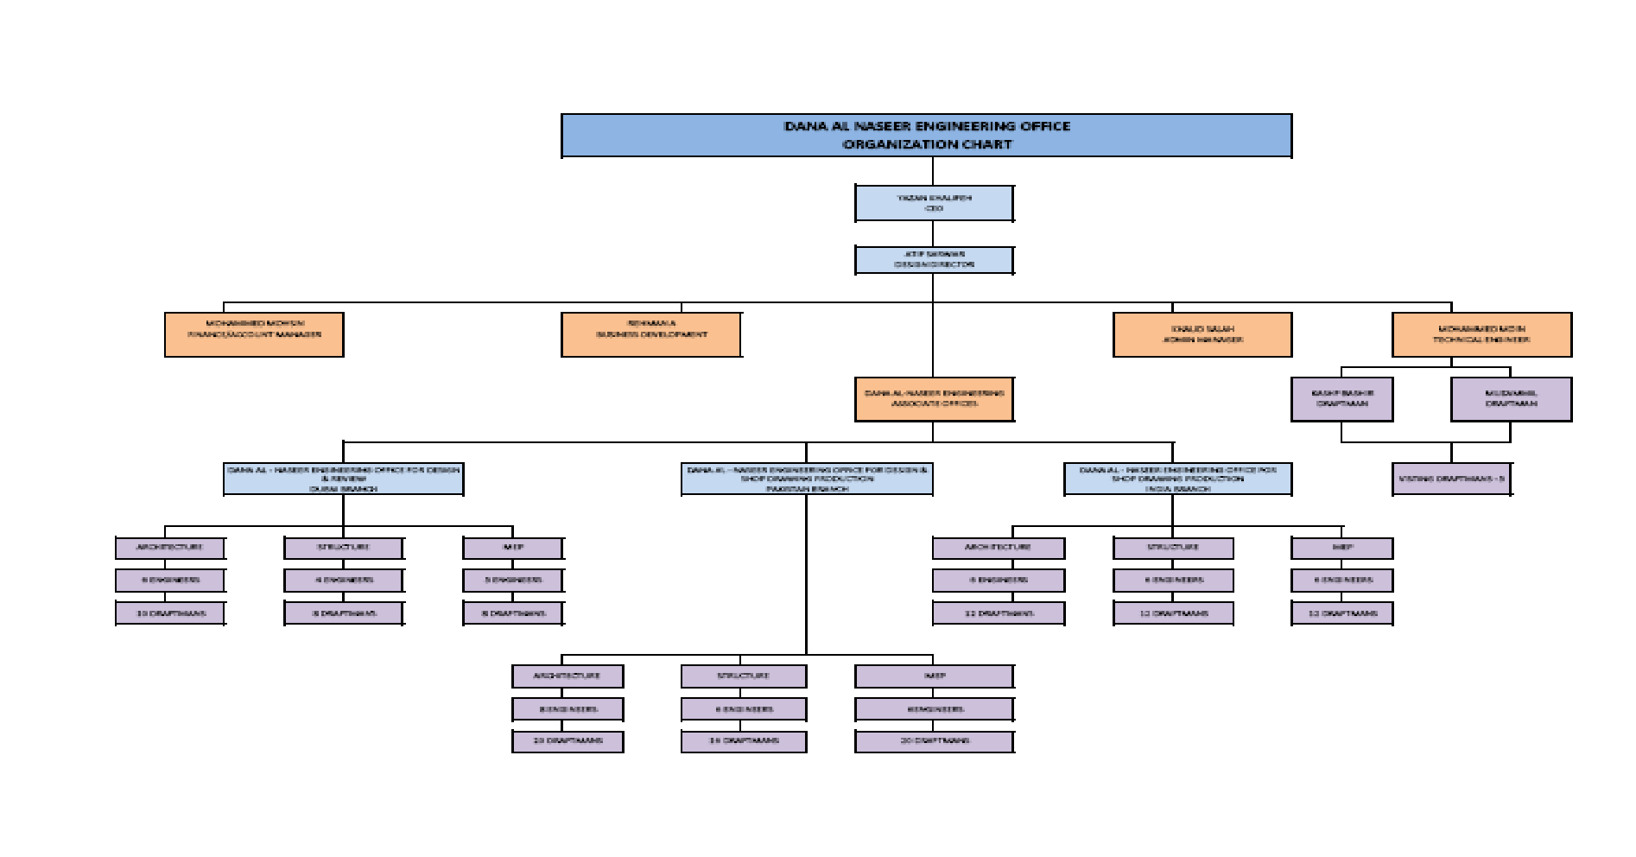
Organization Chart

Slide 6
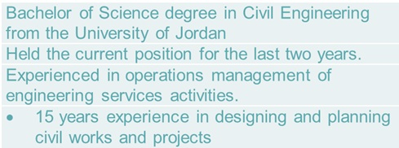
Key personnel
Yazan Khalifeh CEO
Engineer Muhammad Azeem Khan
Bachelor of Science degree in civil Engineering from the University of Jordan 16 years of experience in many engineering fields
Five years of experience in project planning & management
3 years of experience on project coordination
Expert if maintaining all documents and records as per ISO Standards
•20years’ Experience (04 years in KSA & 16 years in Pakistan)
•Bachelor of Science in Civil Engineering
•Master of Science in Civil/Structural Engineering
•PhdFloating Structures
Engr Dana Al Nasser

Slide 7
Role/Discipline | Number of Personnel & Names | Description & Responsibility
Project Manager | 1 (SYED M. ALI MAZHAR) | Overall project direction, client liaison, budget/schedule control, quality assurance, and inter-disciplinary coordination.
BIM Manager | 1 (Engr. Arslan Ahmad) | The BIM Manager is responsible for establishing and enforcing the project's BIM Execution Plan, ensuring all design disciplines produce coordinated models, managing clash detection, and validating the quality of final digital deliverables.
QA/QC Engineer | 1 (Engr. Ali Sufyan) | The QA/QC Engineer is responsible for establishing and implementing the quality assurance and quality control plan, diligently reviewing all design deliverables (drawings, specifications, reports) to ensure they comply with project standards, client requirements, and relevant building codes.
BIM Coordinator | 1 (Engr. Muhammad Riaz) | The BIM Coordinator supports the BIM Manager by facilitating the daily coordination process, managing the file exchange protocols between disciplines, and actively running clash detection reports to ensure the models are integrated, accurate, and clash-free.
Lead Architect | 1 (Ar. Zeeshan) | The Lead Architect is responsible for the overall design integrity, ensuring high-quality technical output across all four villa types and two façade styles, while serving as the primary design point of contact for the Project Manager and client.
Lead Structural Engineer | 1 (Engr. Khursheed-ur-Rehman) | The Lead Structural Engineer will manage the full structural design, analysis, and detailing for all villa types, ensuring compliance with Saudi Arabian building codes and optimizing the system for cost and constructability.
Lead MEP Engineer | 1 (Engr. Tahir Hussain) | The Lead MEP Engineer is accountable for the integrated design, coordination, and technical specification of all Mechanical, Electrical, and Plumbing systems, ensuring energy efficiency and full compliance with local codes across all villa types.
Landscape Designer | 1 (GHULAM MUSTAFA) | The Landscape Designer will execute the detailed design of all exterior villa areas, focusing on cohesive hardscape, softscape, and irrigation plans to enhance the overall aesthetic and functionality of the private villa environment.
Interior Designer | 1 (AHMAD AMMAR) | The Interior Designer is responsible for developing the full detailed interior design package, including fixed joinery, finishes, material specifications, and lighting layouts, to ensure a cohesive and high-end aesthetic for all villa types.
Architectural BIM Modelers | 2 (M. ADEEL SARWAR) (TALHA AHMAD) | The Architectural BIM Modelers are responsible for accurately generating and maintaining the 3D architectural models for all villa types and façade variations, ensuring all building components and data comply with the BIM Execution Plan and design specifications.
Structural BIM Modelers | 2 (ENGR. SIBGHATULLAH) (ABDURREHMAN) | The Structural BIM Modelers are tasked with creating and updating the detailed 3D structural models, accurately representing the foundation, frame, and reinforcement elements in coordination with the architectural and MEP models to facilitate clash detection and accurate quantity take-offs.
MEP BIM Modelers | 3 (ENGR. ZULQARNAIN) (ENGR. SAQLAIN) (ENGR. MUBASHIR) | The MEP BIM Modelers are responsible for modeling all HVAC, electrical, and plumbing systems in 3D, ensuring accurate spatial placement, maintaining system connectivity, and working closely with the BIM Manager to resolve clashes before construction documents are finalized.
Interior BIM Modeler | 2 (ANJUM RASHEED) (AHMAD) | The Interior Design BIM Modeler is responsible for accurately modeling fixed furniture, complex millwork, custom elements, and materials within the villa interiors, ensuring high-fidelity documentation that aligns with the detailed design specifications and coordinates with the architectural model.
Landscape BIM Modeler | 1 (AHMADULLAH) | The Landscape BIM Modeler will create detailed models of the exterior hardscape elements (paving, walls, decking) and essential softscape components, integrating them with the site's topography and coordinating utility routing to finalize the comprehensive landscape package.
Grand Total | 19

Slide 8
Our Affiliated Companies
MM Pakistan:
Offers Complete engineering services with BIM models from LOD100 to LOD500 such as Architectural, Interior, Landscape, Structural, MEP for all stages like concept, Detailed, IFC design, Value engineering, detailing shop & and as-built drawings.
MASA equipment company:
Supply of Construction & cleaning equipment

Slide 9

Our Services
BIM Models (LOD100-LOD500)
Architectural, Interior & Lnadscape Design
Structural & Civil Engineering Design
MEP Engineering Design
Preparation of Design, IFC, shop & As Built drawing for all discipline
Preparation of Project specifications, Tender Documents & Bill of quantities
As Built structures stability design verification, Structural Rehabilitation & Strengthening solutions.
Geotechnical & Soil stabilization Design
Project supervision
Urban Planning
Fire & Life Safety Design & Issuing Civil Defense License
Quality Control &Cost Control
Urban planning

Slide 10
We currently operate in:
Saudi Arabia
Kuwait
Dubai
Iraq
Pakistan

Slide 11
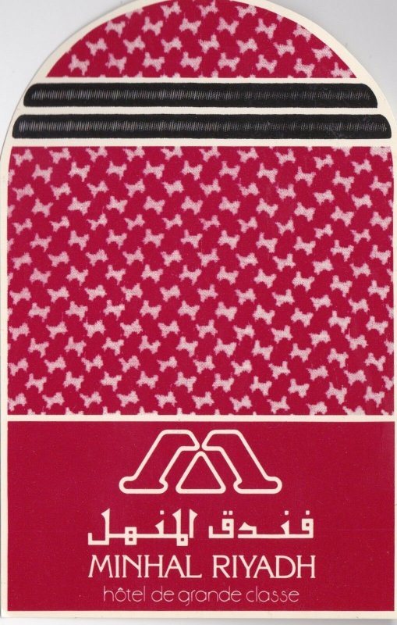














Our clients

Slide 12

Our Experiences

Slide 13
Our Projects
SOUTH SURRA ROAD INTERCHANGE & BRIDGES KUWAIT
Rashidiya Park Ride Stations Dubai
Vehicle Access Tunnel – MiSK City, KSA
The Mosul Second Bridge, Iraq: (Rehabilitation design done)
Minhal Crowne Plaza Extension: Riyadh Minhal Company, IHG, Ridco & SCEC-Khatib & Alami
Radisson Blu Hotel Prince Salman Center for Disability, Ridco, Omrania & Associates
King Abdul Aziz Military Academy: Ministry of Defense and Aviation, Isam Kabbani & Partners
ITCC Al Rajhi Projects, Shop drawings
Olaya Towers Nesma/Zuhair Fayaz, Curtain wall shop drawings
MOI Project CADO, Design Review & Design services for Design and Built Project

Slide 14
MOI Project YMES, Design Review & Design services for Design and Built Project
Al Fanar Labour Camp Al Khateeb Contracting, Design Review, & Design services for Design and Built Project
Samba Tower Al Saif, Shop drawings
120-Bed Hospital Malaz Riyadh, Soil Shoring Project includes Soil Anchors & Shotcrete works
SEC AL Kharj office, Soil Shoring Design includes Soil Anchors & Shotcrete works
Al Akaria Mixed Use Building- Soil Shoring Design (Shotcrete & Anchors Design) (September 2018)
Al Ghanem Car Parking-Soil Shoring Design (Shotcrete & Anchors Design) (June 2018)
MOI-Security Forces Medical Center Hospital Core Walls (July 2018)
Ghadeer PUS Rehabilitation-Fitness Club, Sports Center, strengthening by using CFRP, steel beam, steel & Concrete jacketing (2017-2018
Dammam Airport Terminal Building, signal Tower & runway design modifications.

Slide 15
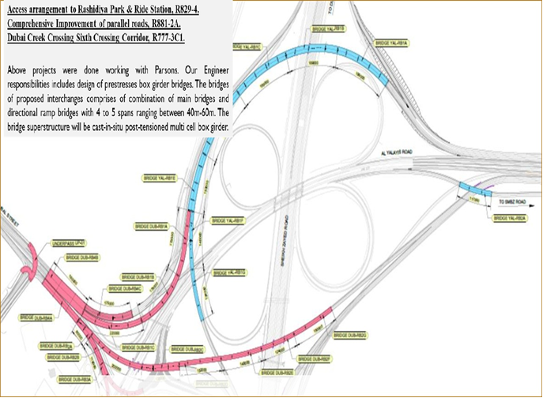
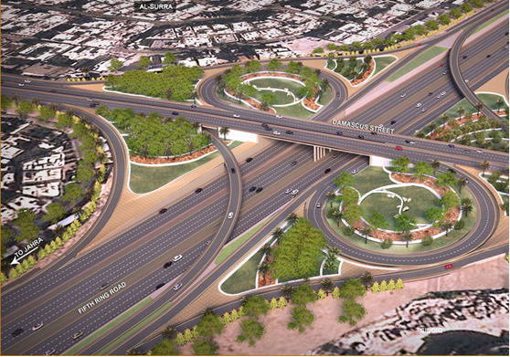
Rashidiya Park & Ride Station

Slide 16
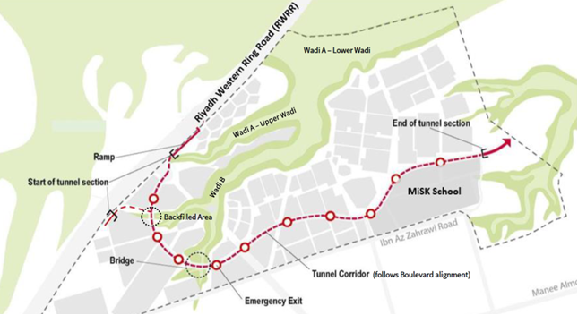
Vehicle Access Tunnel – MiSK City, KSA

Slide 17
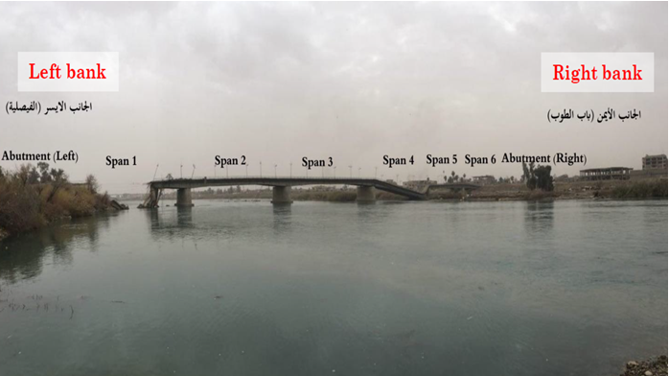
The Mosul Second Bridge, Iraq: (Rehabilitation design done)

Slide 18
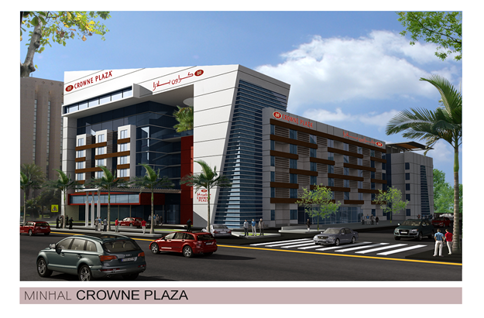
Minhal Crowne Plaza Hotel Extension

Slide 19
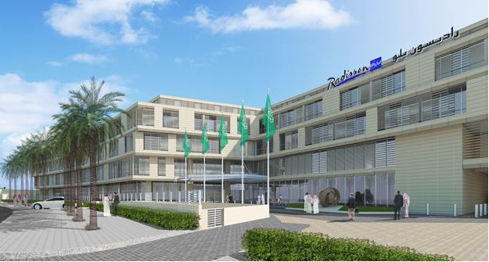
Radisson Blu Hotel DQ Riyadh

Slide 20
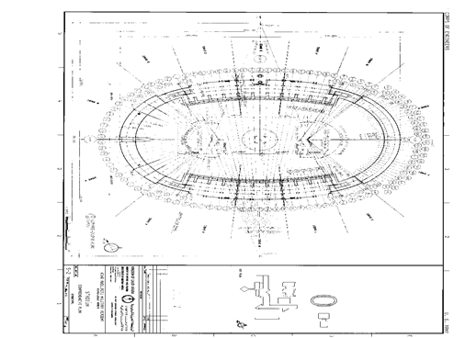
King Abdul Aziz Military Academy Buildings & Stadium Rehabilitation & Strengthening

Slide 21
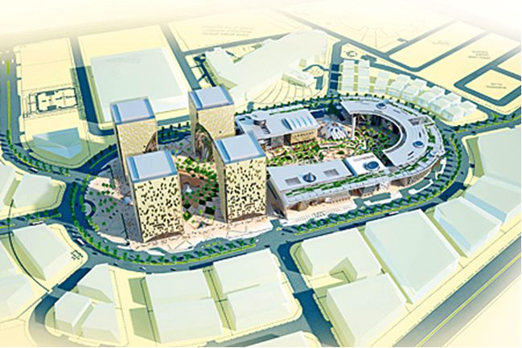
Information Technology Communication Complex Towers (ITCC)

Slide 22
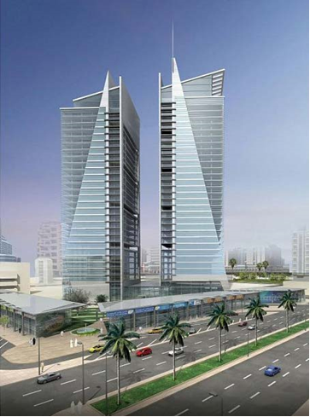
Olaya Towers

Slide 23
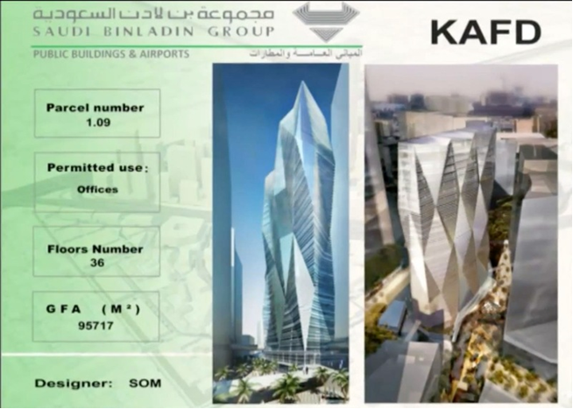
KAFD PARCEL 1.09

Slide 24
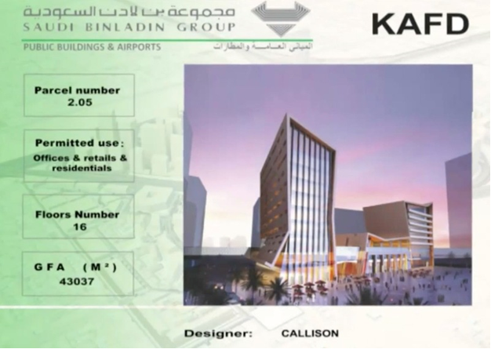
KAFD PARCEL 2.05

Slide 25
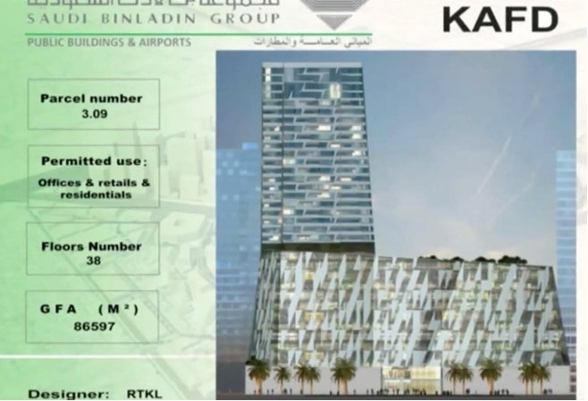
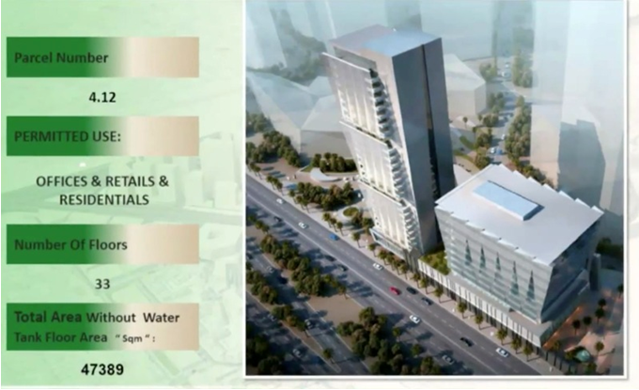

Slide 26
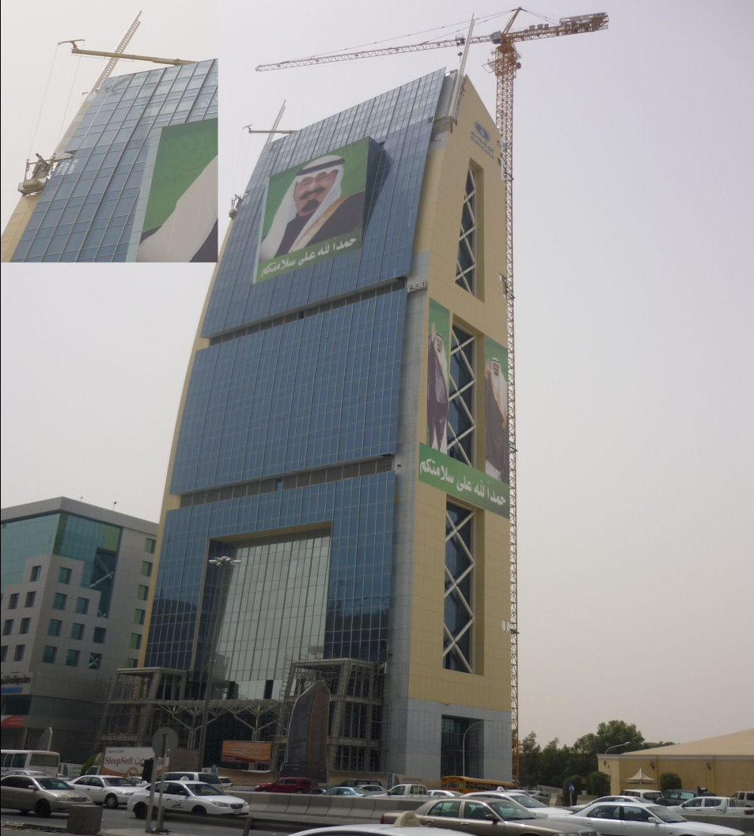
AL Mounajem Tower

Slide 27
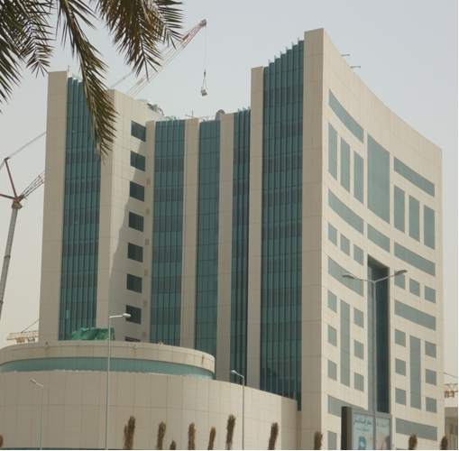
Higher Education Tower

Slide 28
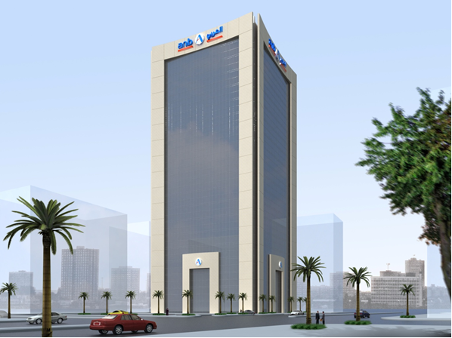
Arab National Bank

Slide 29
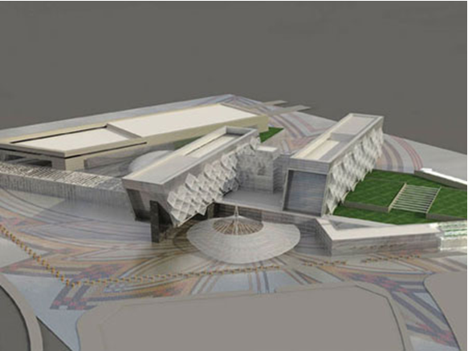
ITCC Conventional Hotel

Slide 30
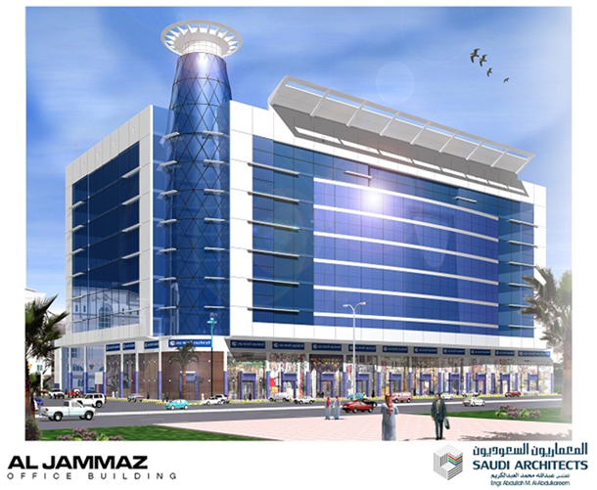
Al Jammaz building

Slide 32
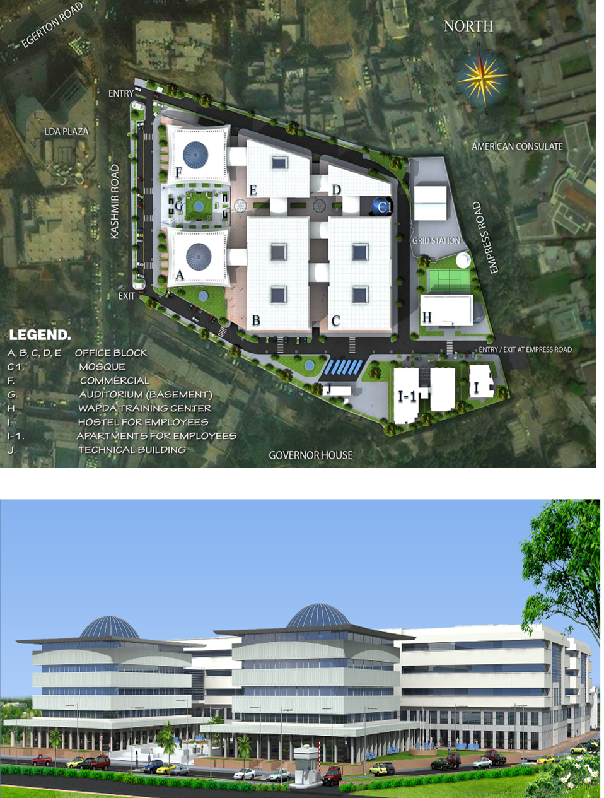

Slide 33
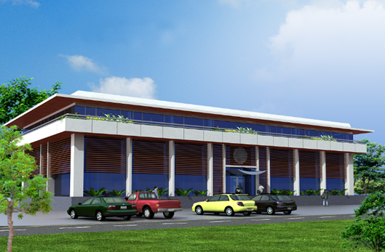
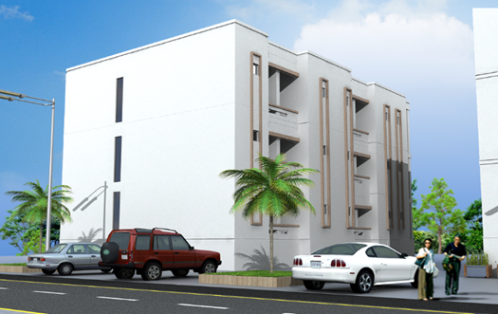
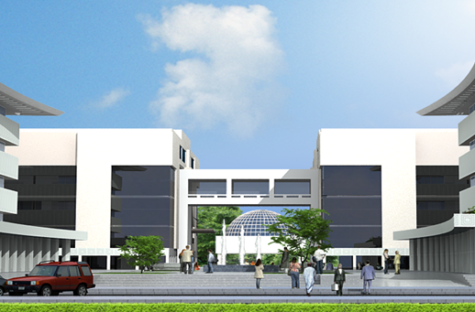
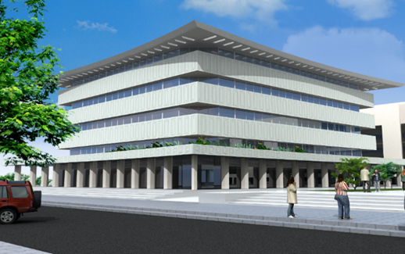

Slide 34
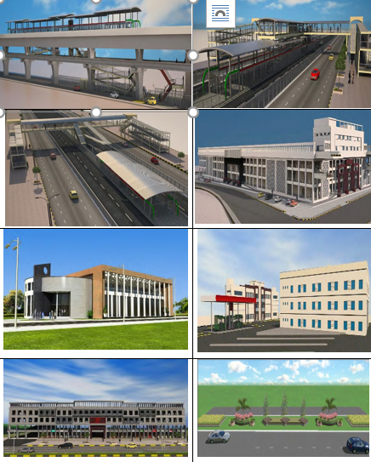

Slide 35
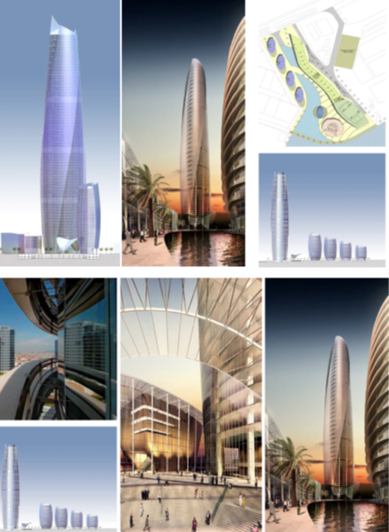

Slide 36
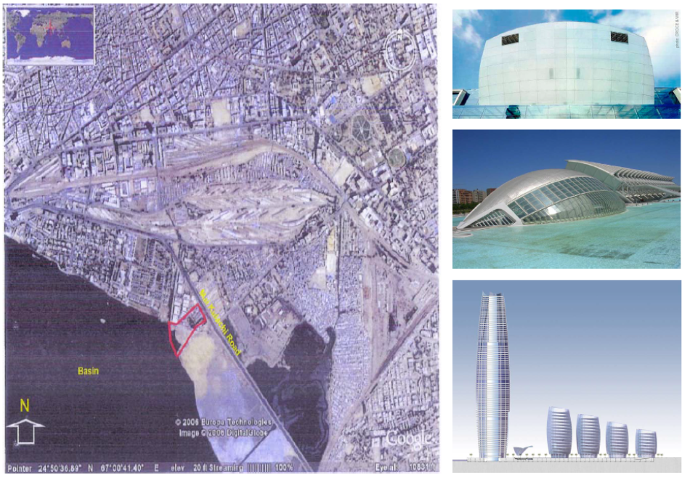

Slide 37
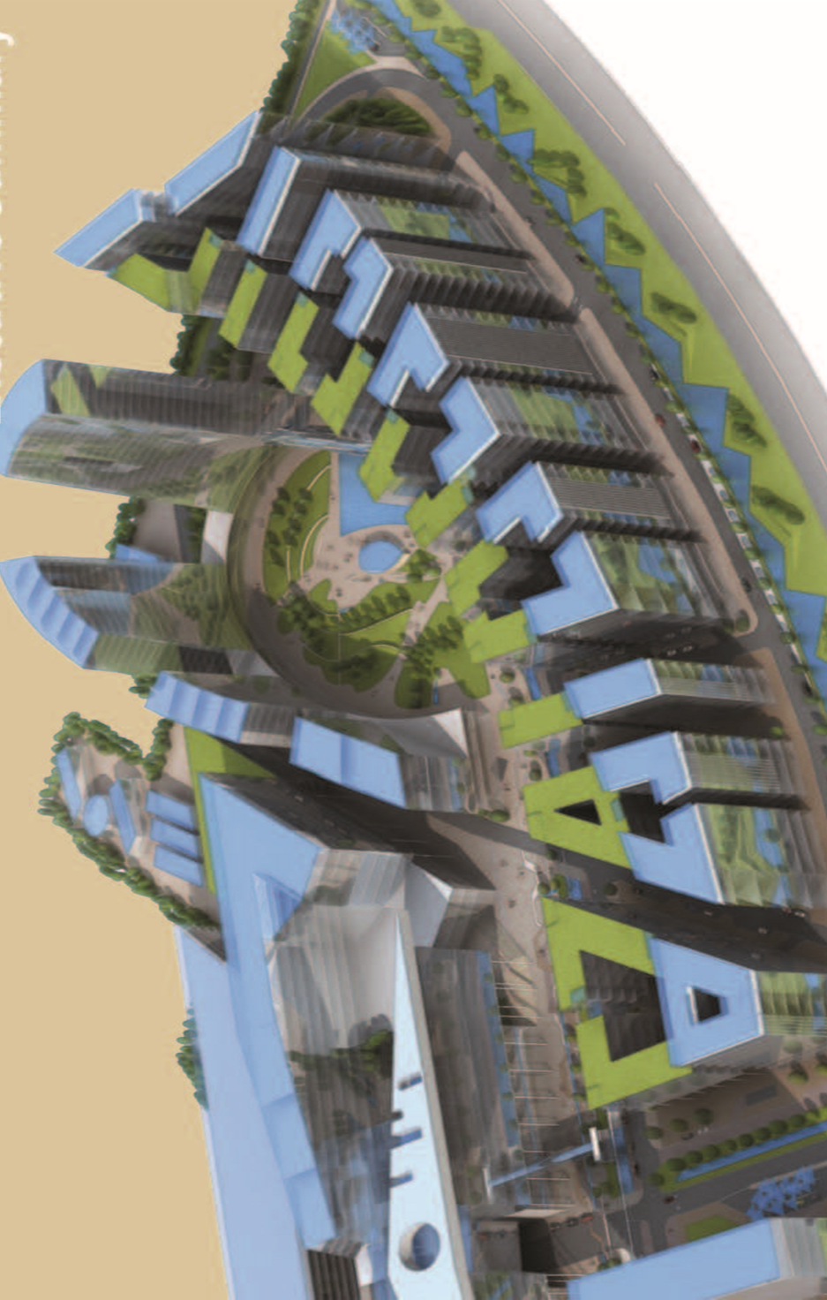

Slide 38
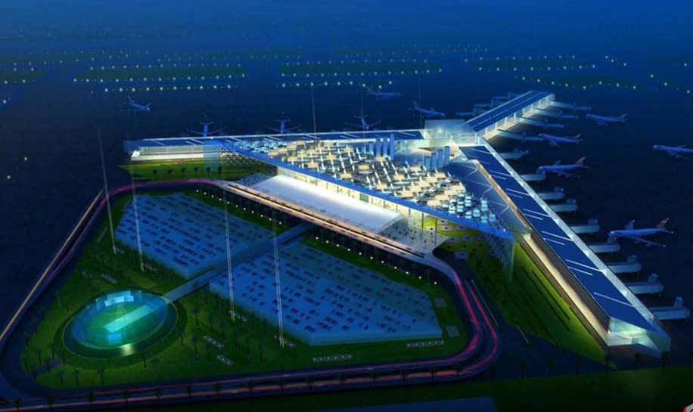

Slide 39
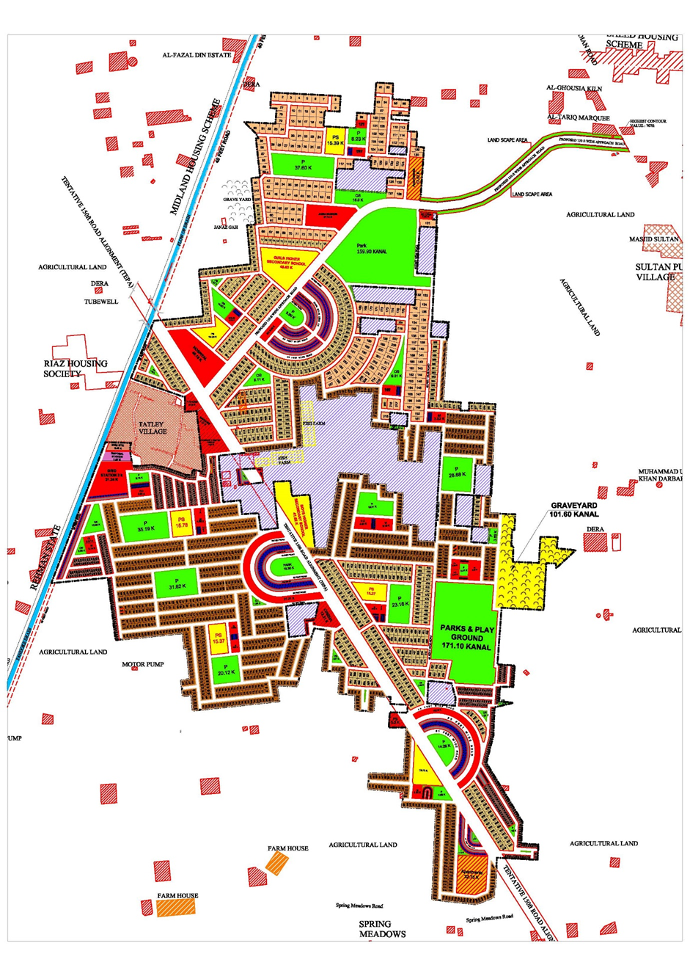
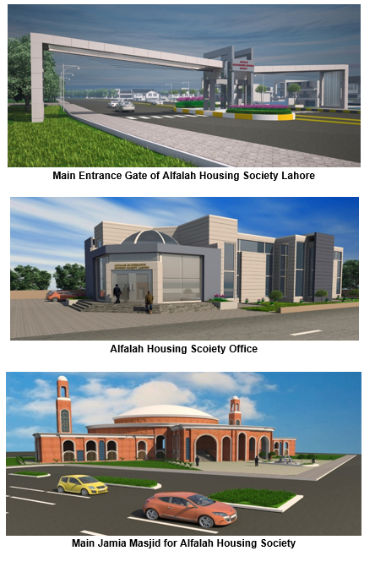

Slide 40
Certifications and Registeration documents

Slide 41
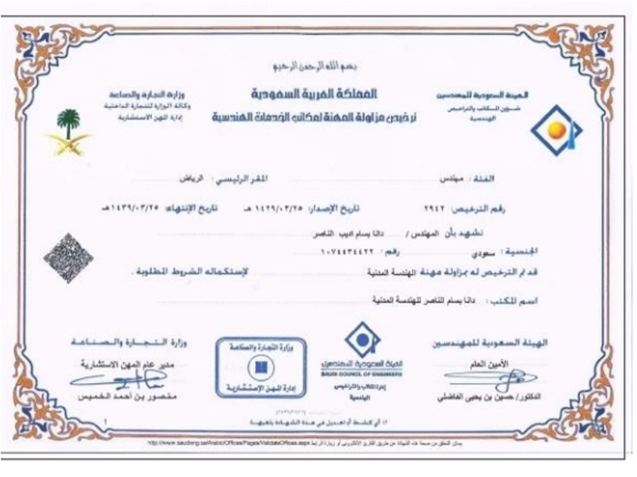

Slide 42
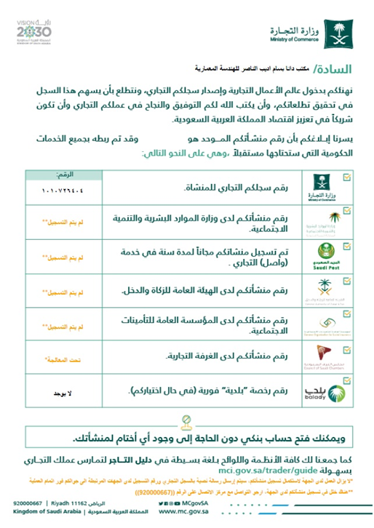
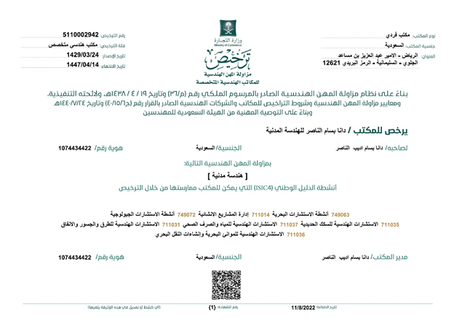

Slide 43
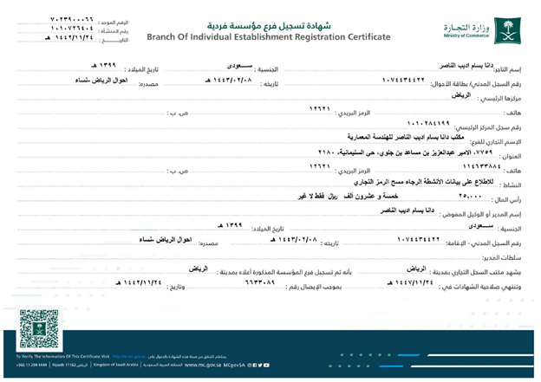

Slide 44
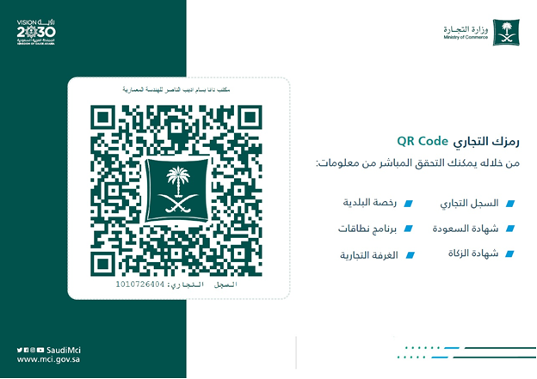

Slide 45
